Slide 1
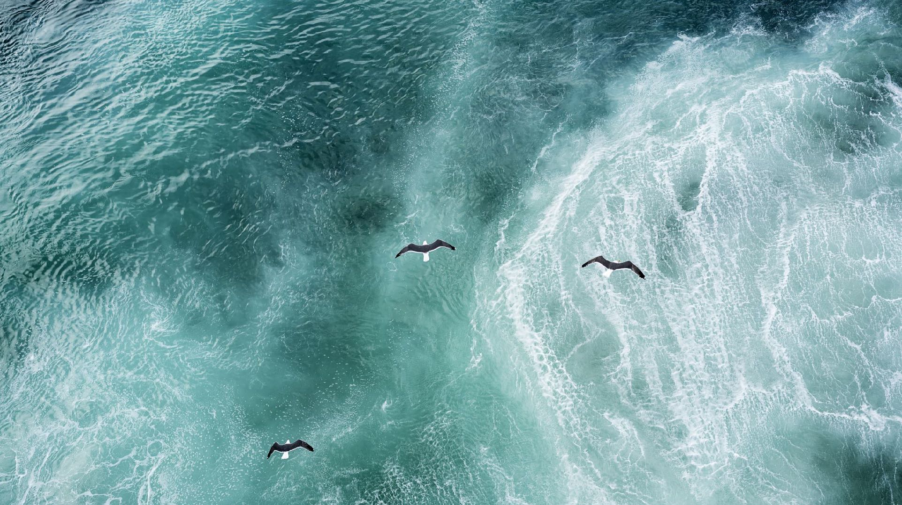
Our Journey to Madeira
Helena Bosch

Slide 2
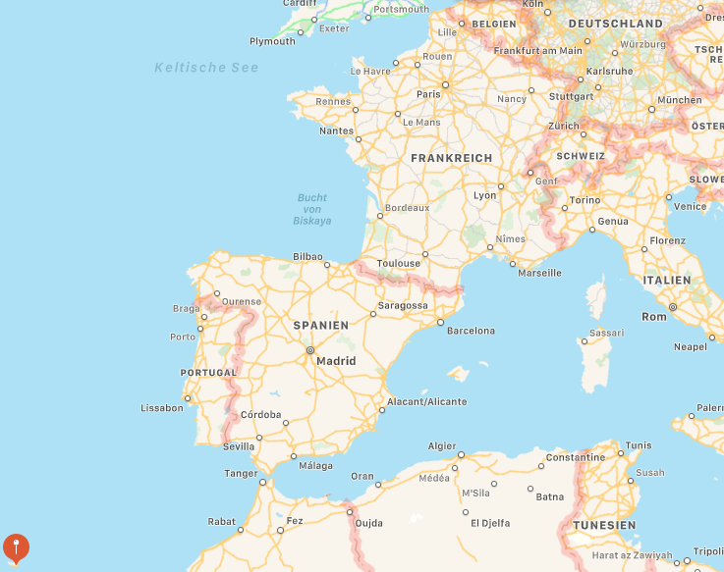
We flew from Stuttgart to Lissabon in Portugal and then from Lissabon to Funchal, Madeira, also Portugal.

Slide 3
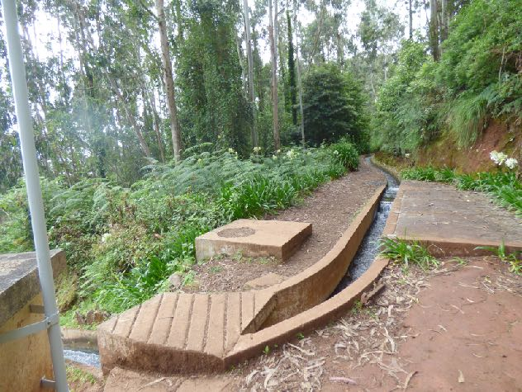
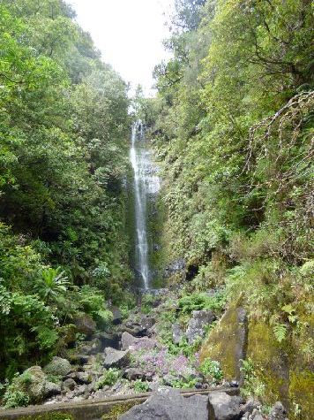
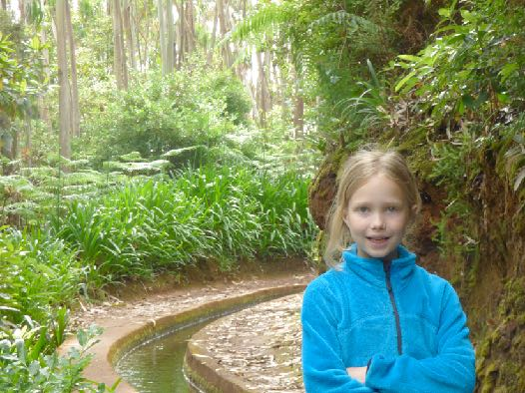
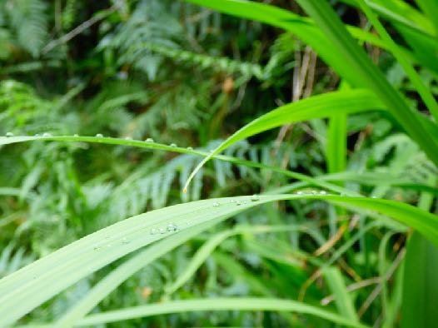
The Levadas
In Madeira, there are many little canals. You can walk beside them. All the plants are green there and it‘s never too hot. I took a lot of photos of my little sister.
You can see amazing waterfalls like the one on the picture on the right.

Slide 4
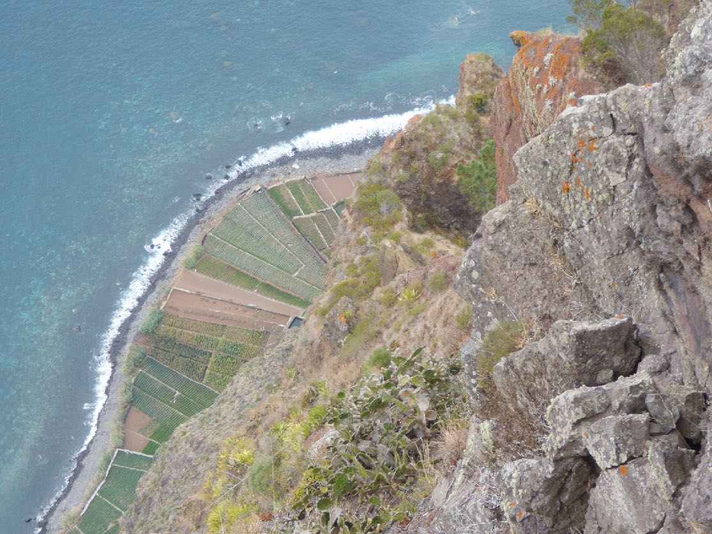
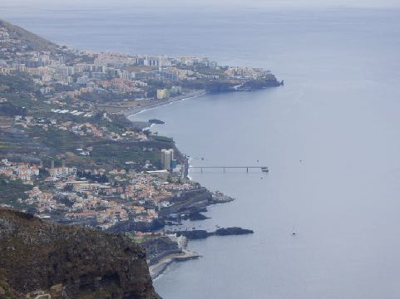
The view
On many walks you have exciting views.

Slide 5
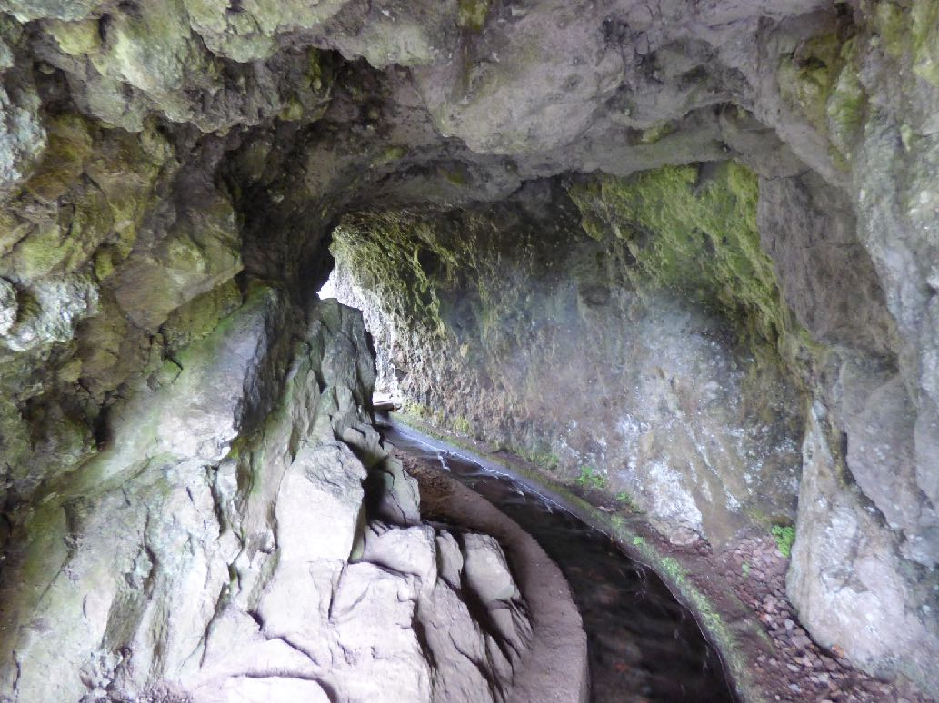
The tunnels
The canals sometimes go through tunnels. One of them was about 1000 meters long!

Slide 6
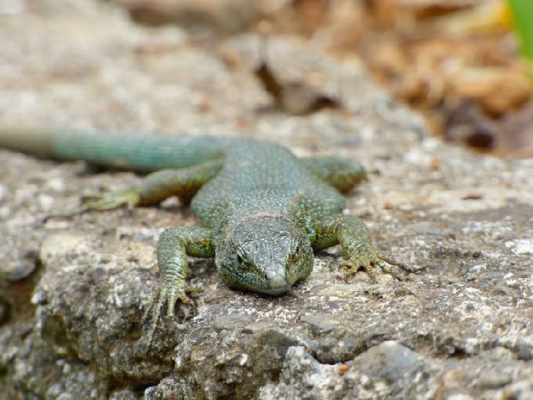
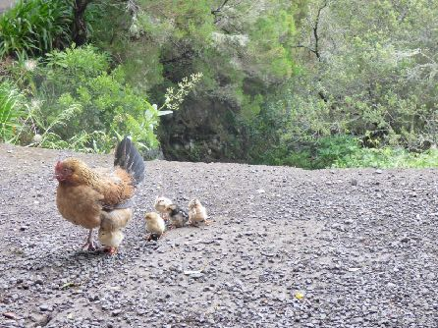
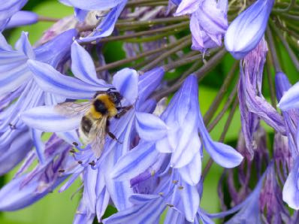
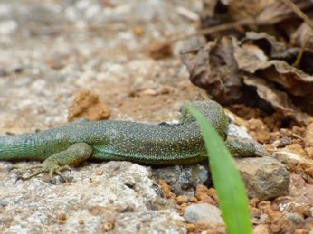
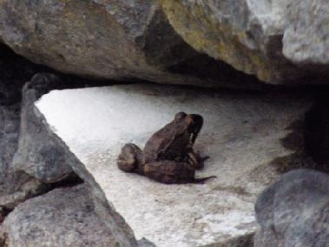
Many animals
Because of the wet weather and the few cats there are many lizards. They are living between stones in small walls.
There were many frogs too.
On one walk we saw little chickens.

Slide 7
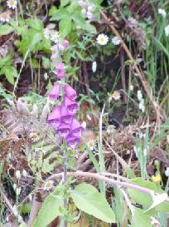
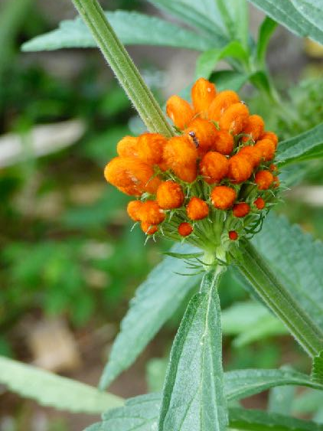
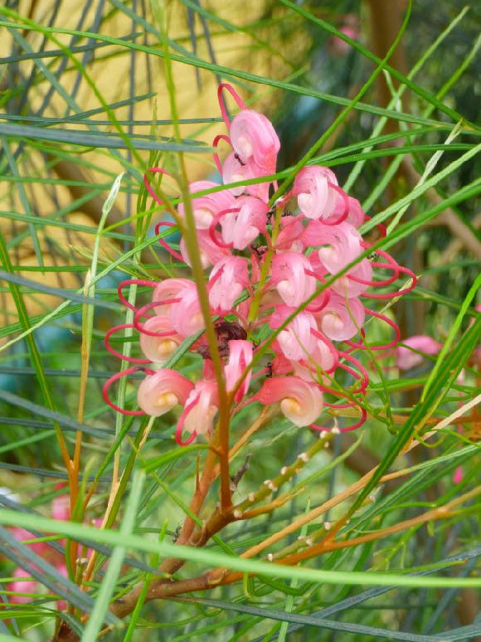
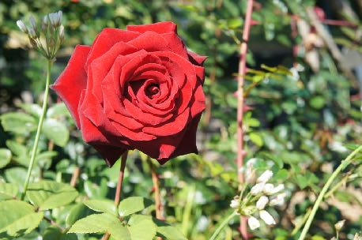
Flowers
In our hotel there were a lot of beautiful flowers I can‘t name.

Slide 8
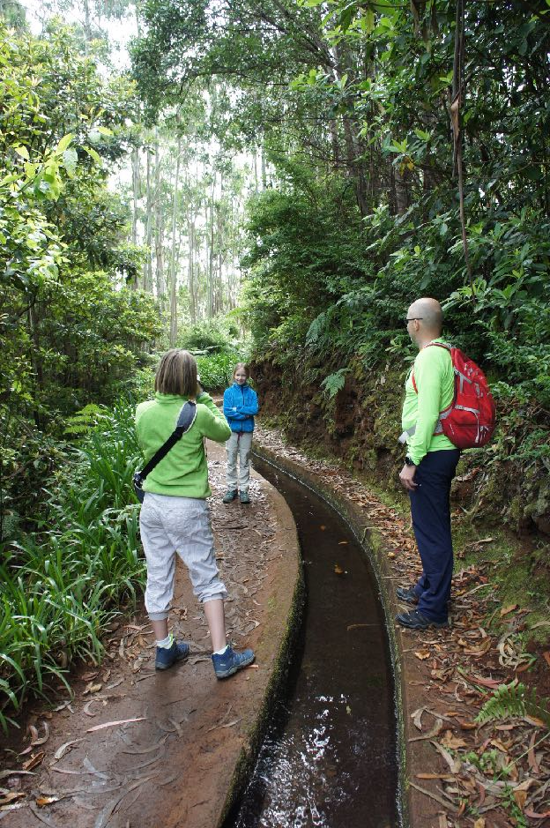
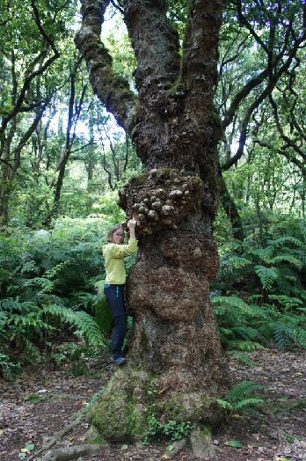
We had a wonderful time
There are not so many pictures of me because I was the one who took most of the photos - but I hope that doesn‘t matter. I am the one who wears a green or yellow jacket.

Slide 9
